Slide 1

Politecnico di Milano
A.A. 2015-2016
Software Engineering 2 project: MyTaxiService
RASD
(Requirements Analysis and Specification Document)
Alessandro Pozzi (matr. 852358), Marco Romani (matr. 852361)

Slide 2
Definitions
Customer –Registered user that may demand a taxi ride.
Standard customer – Person who is not using MTS’s applications but may still require a ride with the “traditional” method.
Taxi Driver – Employee of the taxi service.
Taxi zones –2km² areas in which the city’s territory is divided. Each taxi queue is associated to a single taxi zone and vice versa.

Slide 3
Definitions
Request – Customer’s demand to be picked up by a taxi, sent using the web or mobile application.
Reservation – Ride that has been reserved by a customer using the web or mobile application. It becomes automatically a request 10 minutes before the established time.

Slide 4
Definitions
Taxi driver availability – The status of a taxi driver.
In detail, these are the 2 possible status of a taxi driver:
Available – When the driver has no customer to pick up and it’s ready to accept new requests.
Busy – When the driver is taking care of a request or of a standard customer. Note that the taxi driver is considered “busy” even if he hasn’t pick up the customer yet, but has only accepted his request.

Slide 5
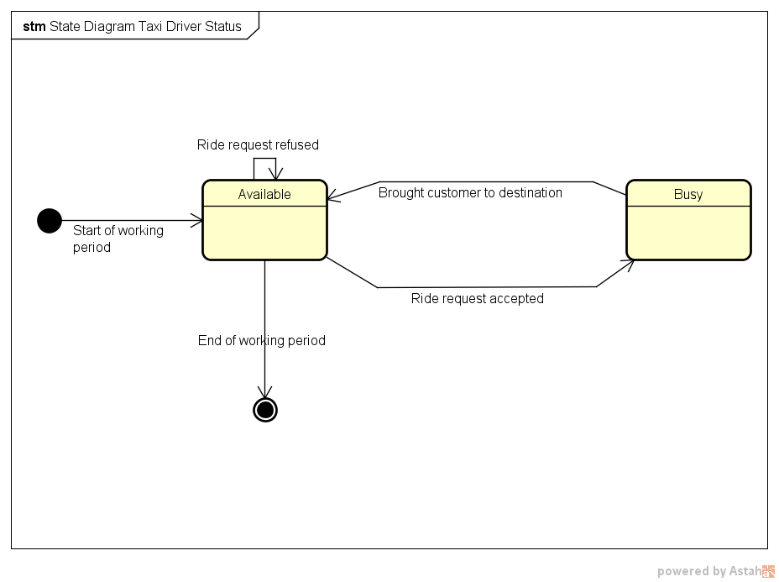
In this case ‘’ride request’’ is meant to be any ride request, possibly a request from a standard customer or maybe a reservation which is seen as a request from the driver’s point of view.

Slide 6
Definitions
Customer and taxi driver pair – Sometimes taxi drivers and customers are said to be “paired”: this happens only after a requests or 10 minutes before a reservation, when the system chooses a taxi driver to serve the customer. Basically it corresponds to the ride status Assigned. This association ends when the taxi drops the customer to the requested destination.

Slide 7
Definitions
In detail, these are the possible status of a taxi ride:
NotAssigned – This is the default status of a taxi ride requested by customers. It simply means that the request (or reservation) has been accepted by the system but nothing else has been done yet.
Assigned – Appears when the system has assigned a taxi to the customer.
Completed – When the taxi driver has brought the customer to destination and has declared himself “Available”.
Annulled – When the customer has deleted the request (or reservation).

Slide 8
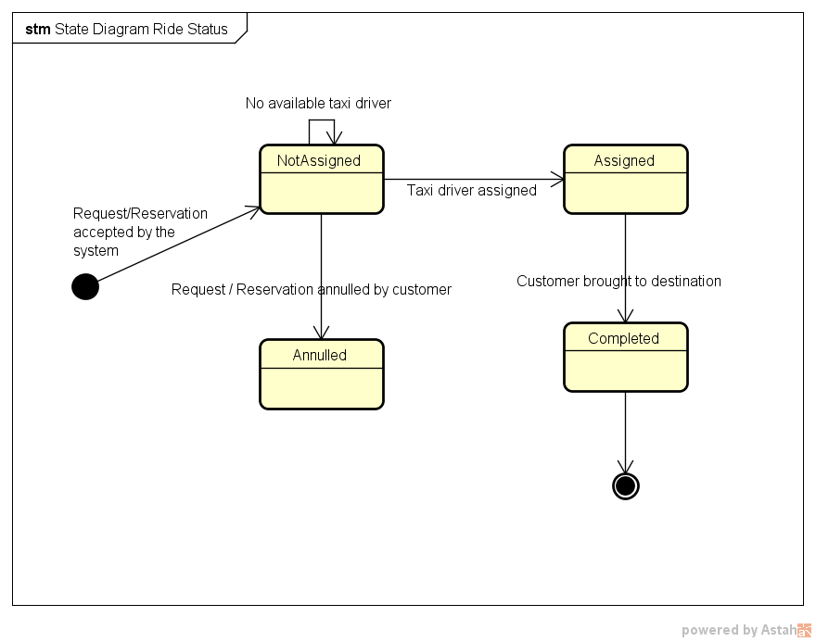
In this case ‘’ride’’ means only rides or reservations made by registered customers.

Slide 9
Domain Assumptions
Requests and reservations can be cancelled if and only if no taxi have been assigned to the customer.
Customers and taxi drivers access to the same mobile app. The available functions will depend by the login phase, which determines the type of user connected.
A taxi driver account cannot be used as a customer account, and vice versa. This means that if a taxi driver wants to access the customer’s services, he will need to create a customer account.
Taxi drivers can log into the web application with theirs driver’s account but cannot access to the customers’ service. The only available function will be the modification of some account information.

Slide 10
Domain Assumptions
Taxi drivers will manually update their status (available or busy) with the mobile app every time they pick up or drop off standard customers. On the contrary, when drivers accept a ride request by MTS customers, the “busy” status will be automatically set up by the system. Anyway, the “available” status must still be selected manually after the customer has been taken to destination.
Taxi drivers have a fixed amount of time of 1 minute to answer a ride request. If the answer is not received, the system will consider the request as refused and act accordingly.
Customers are allowed to perform unlimited taxi reservations. However, due to the fact that overlaps between two reservations are not predictable, the system will cancel any impracticable reservation identified at runtime.

Slide 11
Domain Assumptions
Customers are not allowed to request a taxi ride if any other request made by the same account has not been fulfilled yet.
If and only if a taxi zone does not have any taxi available to answer a request, the system will search for an available taxi in adjoining zones. Worst case scenario: if there are no taxi available in the adjoined zones, the costumer should be notified and put in hold. During this period of time the costumer should be allowed to cancel the request.
Taxis are assumed to be well distributed in the city’s taxi zones. This means that taxi zones never happen to be completely empty and the situation in which no taxi drivers are present, either available or busy, cannot occur.

Slide 12
Domain Assumptions
Payment and specific duties related to the taxi service are not considered and managed by the application. MyTaxiService is meant to be only an interface between customers and taxi drivers.
The web and mobile registration is intended for customers only. Taxi drivers’ account are created by an administrator when they are hired by the taxi company. Taxi drivers will then receive their username and temporary password, which they will be able to change once logged in the application.
The system will not accept reservation whose date is latter than a year in respect to the submission date.

Slide 13
Overall Description
Product perspective
The applications to be developed is not completely independent and self-contained:
it will rely mainly on the GPS system in order to retrieve the position of all its taxis.
possible future integrations and extensions by releasing a set of APIs so that MTS may be exploited by other companies and developers and integrated with similar services.
APIs will also provide an easier development of additional functions, like taxi sharing or a SMS-based reservation system.

Slide 14
Overall Description
User characteristics
Two types of users: taxi drivers and customers.
No particular skills or information technology knowledge are required, since the application will be easy to use and accessible by any mobile phone or computer that have access to internet.

Slide 15
Overall Description
Future possible implementations
The implementation of a taxi sharing service, which allows customers to share their ride with other users in order to decrease the cost of the ride.
The implementation of a SMS system, which allows users to request or reserve a ride by sending a SMS. SMS syntax rules may be available online or may be sent by request with a SMS. This function may extend the service to those who does not have always access to an internet connection, like tourists.

Slide 16
Overall Description
A function that estimates how much time a ride will take and how much it will cost. This function may be accessible even without requesting a ride.
An improved taxi management system, which redistributes available taxis moving them from high density areas to low density areas.
The possibility to show the GPS position of the customer’s taxi on an interactive map.

Slide 17
Goals and functional requirements
[G1] Allow customers to access the system’s taxi service in any moment, whether they are at home or anywhere else in the city.
[R1] Customers should be able to access the service through both the web and the mobile application, even at the same time.
[R2] Customers must be able to register to the taxi service from the mobile or web homepage.
[R3] Only registered customers can access MTS’s services.
[R4] The system should allow the log out functionality.

Slide 18
Goals and functional requirements
[G2] Allow customers to request a taxi ride from an arranged location.
[R1] Only registered customers can request a taxi ride.
[R2] Customers must insert a valid origin location in order to request a ride.
[R3] The system will not allow more than a request if the previous one (either request or reservation) has not been accomplished yet.

Slide 19
Goals and functional requirements
[G3] Allow customers to reserve a taxi ride at a specific time with a given origin and destination.
[R1] The system should allow taxi reservations for a specific path communicated by the customer.
[R2] The system must not allow overlaps between reservations (or requests) made by the same customer.
[R3] The system allows reservations only 2 hours before the time and date specified by the customer.
[R4] The system will assign a taxi driver for the reserved ride 10 minutes before the time and date specified by the customer.

Slide 20
Goals and functional requirements
[G4] Allow taxi drivers to answer a ride request and take care of customers.
[R1] Taxi drivers should be able to communicate their current availability state to the system.
[R2] If available, taxi drivers should be able to receive incoming requests.
[R3] After receiving an incoming request, the taxi driver should be able to either confirm or not his intention to take charge of the request.
[R4] Taxi drivers must be able to log in the mobile application with preassigned credential and be identified as drivers.

Slide 21
Goals and functional requirements
[G5] A ride request should always be satisfied within a considerable short amount of time, 15 minutes on average.
[R1] The system should always search an available taxi giving maximum priority to the taxi zone related to the request and lower priority to the immediate near zones. Any other taxi zone should be ignored.
[R2] If no taxis are available in the zones specified in the previous requirement, the system should put the request on hold and periodically check again the taxi availability.

Slide 22
Goals and functional requirements
[G6] Allow customers to be notified of any relevant update connected to their requests and reservations.
[R1] The system should send updates through email and/or in-app notification, as specified by the customer.
[R2] Absence of taxis available, reservations overlaps, taxi average waiting time and taxi assigned to customers are events that must be notified to the customer.

Slide 23
Goals and functional requirements
[G7] Customers and taxi drivers must be able to contact each other after the system has paired them.
[R1] Customers must leave a valid phone number in order to complete the registration phase.
[R2] Taxi drivers must be able to access to the customer’s phone number when the system has paired them.
[R3] Customers must receive the taxi drivers’ contact number after the system has paired them.
[R4] Customers must receive the taxi code in order to be able to recognize its driver.

Slide 24
Goals and functional requirements
[G8] Allow customers to delete requests and reservations.
[R1] Customers can delete a request or reservation only if it has not been assigned to a taxi driver yet.

Slide 25
Goals and functional requirements
[G9] Administrators must be able to assign and manage an account to the taxi drivers hired by the company.
[R1] Administrators must be able to create a taxi driver’s account.
[R2] Administrators must be able to delete a taxi driver’s account.

Slide 26
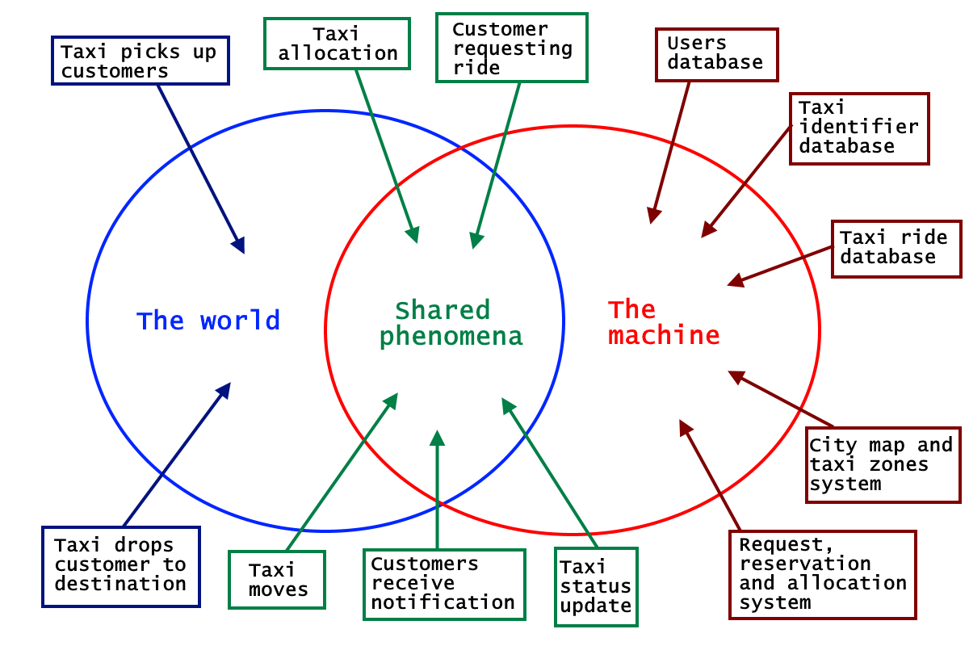
The world and the machine

Slide 27
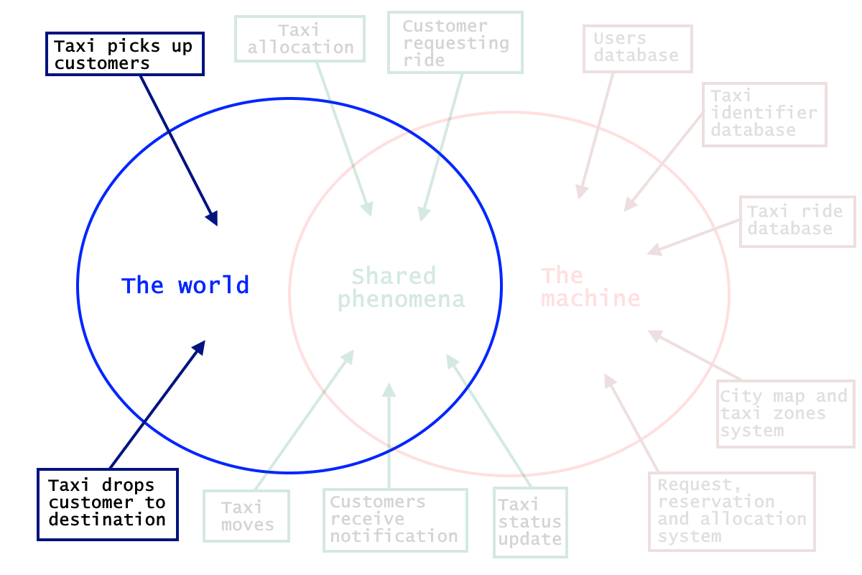
The world
Taxi picks up customers – happens exclusively in the world and it is not observed by the machine
Taxi drops customers to destination – it is not seen by the machine, which can only see the driver’s change of status

Slide 28
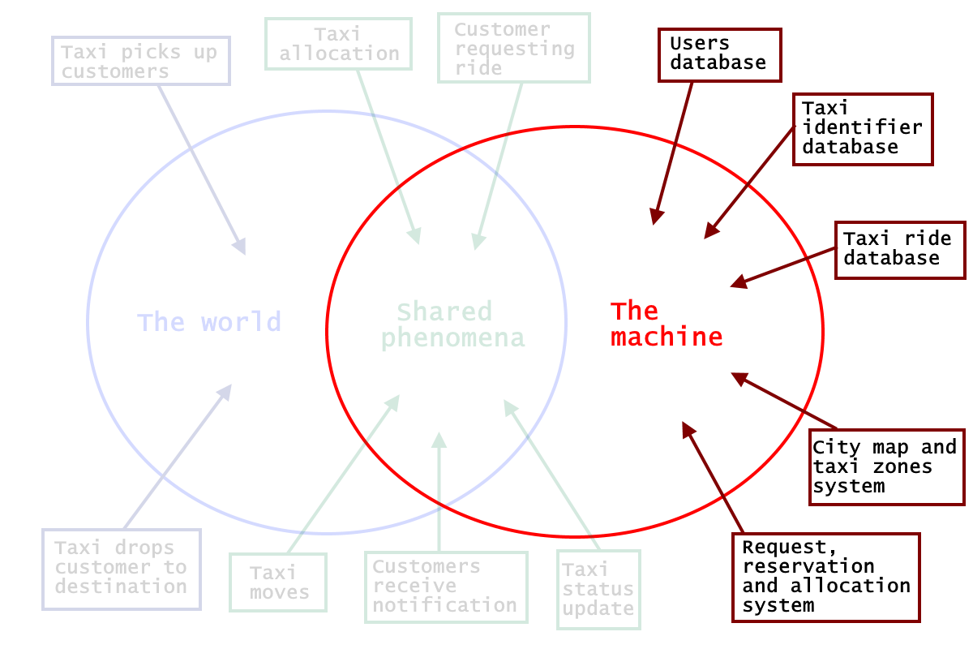
The machine
Users database – Contains all the users’ accounts: Admins, Taxi drivers and Customers
Taxi identifier database - contain all the information about taxis and their assigned drivers.
Taxi ride database - Store all the information regarding actual, past and future taxi rides
City map and taxi zones system – Contains and manages the taxi zones and the queues
Request, reservation and allocation system – manages the main application logic

Slide 29
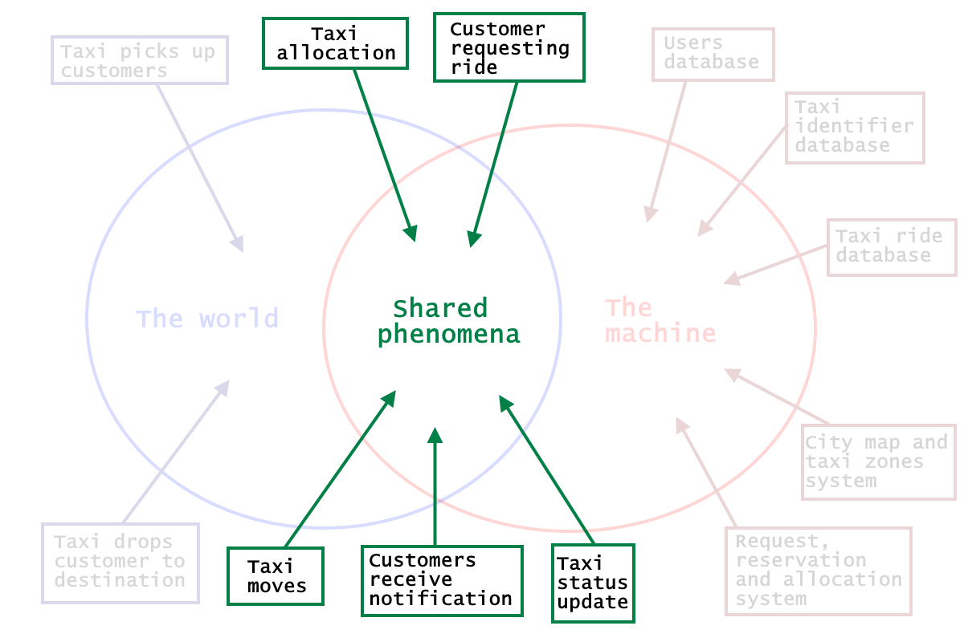
The Shared Phenomena
Taxi allocation - is a particular entity: if we consider MTS customers, is observed by the world and controlled by the machine (which sets the taxi’s next destination accordingly to the customer requests); if we consider standard customers, then it is observed by the machine (with the GPS and taxi zones system) and controlled by the world (i.e. the standard customer).
Customer requesting ride - happens in the world and is only observed by the machine, which will react accordingly.
Taxi moves - is a shared phenomenon, which is controlled by the world and observed by the machine through the GPS system.
Taxi status update - is also a phenomenon controlled by the world (i.e. the taxi driver that changes their status by picking up and dropping of customers) and observed by the system.
Customers receive notifications - is machine-controlled, since customers receive updates about their rides by the system.

Slide 30
Non functional requirements
[N1] MyTaxiService’s system should be available 24/7.
[N2] The waiting time for a taxi to come that is showed to customers should be updated every 30 seconds.
[N3] Every functionality offered by the mobile or web application after the login should be reachable within three clicks.

Slide 31
Non functional requirements
[N4] Mobile applications’ button available to taxi drivers should be big enough to be easily recognized and pressed while driving.
[N5] Email sent to the user in order to confirm registration should arrive in less than 10 minutes.
[N6] Web and mobile applications should have a similar graphics so that the correlation between the two would be immediately identified by customers.

Slide 32
Non functional requirements
[N7] Mobile’s notifications should appear even when the user has not the app opened.
[N8] The description of the mobile application in the phone app store should point out clearly and briefly its functions, allowing a quick comprehension from any type of user.
[N9] MyTaxiService’s applications should always have imperceptible response time during the navigation within its forms.

Slide 33
Scenario with mockups
Let’s see a possible scenario of use of MTS’s application with some explicative mockups.
Suppose that the student Luca Bianchi has to go to Politecnico di Milano to have an exam.
Unfortunately, TRENORD has other plans: in fact, a strike is arranged exactly the day of Luca’s exam.
Knowing that, Luca cautiously decide to reserve himself a taxi using an application his friends have been talking about: MyTaxiService.
He turns on his laptop and after a quick google search he finds MTS’s website.
.

Slide 34
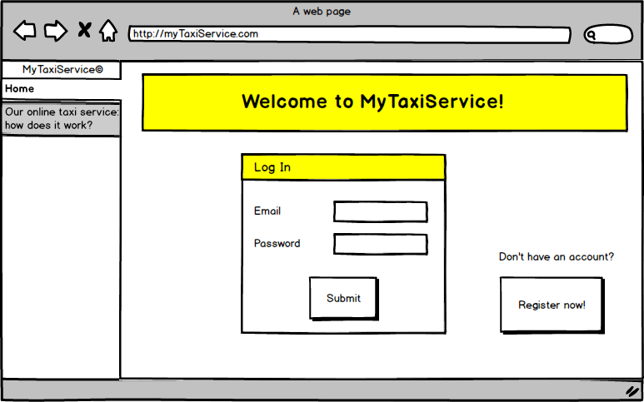
This is how the home of the web application looks like:
Luca has never used MyTaxiService before, so he doesn’t have an account.
Since an account is required to access MTS’s services, he clicks on the “Register now” button.

Slide 35
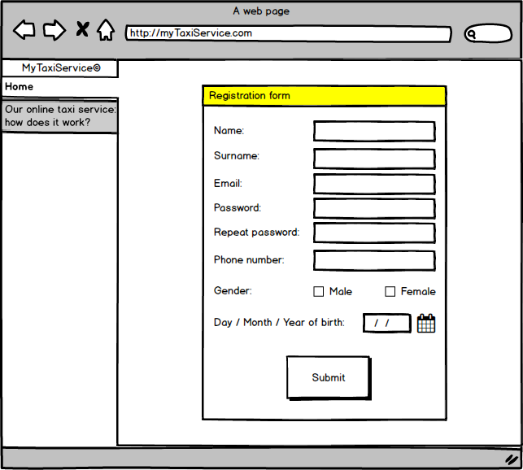
The following registration form appears.
Luca quickly fills in all the fields and clicks “Submit”.

Slide 36
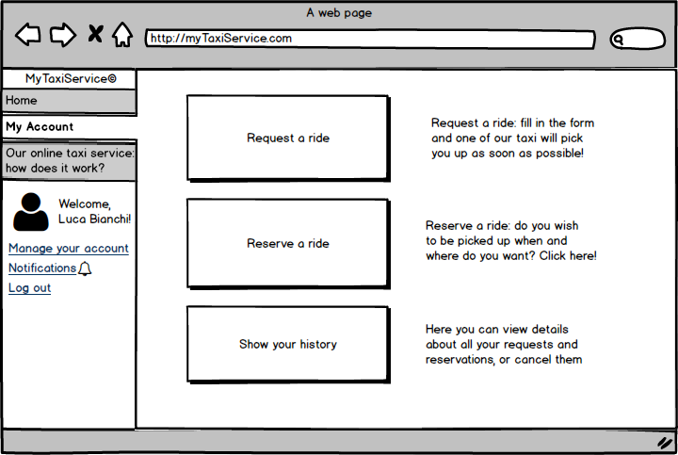
A few minutes later, Luca receives an email that confirms his registration. He goes back to MTS’s home, fills in the email and password fields, and logs in. The following screen appears:
The “Reserve a ride” service seems to be suitable to Luca’s needs, so the student clicks on the correspondent button.

Slide 37
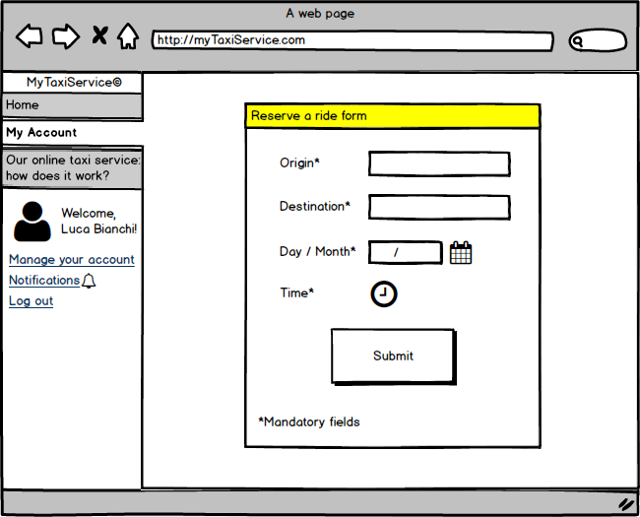
Luca compiles the following form with required information.
He presses the “Submit” button, and shortly after a pop-up confirms that his reservation has been accepted by the system.

Slide 38
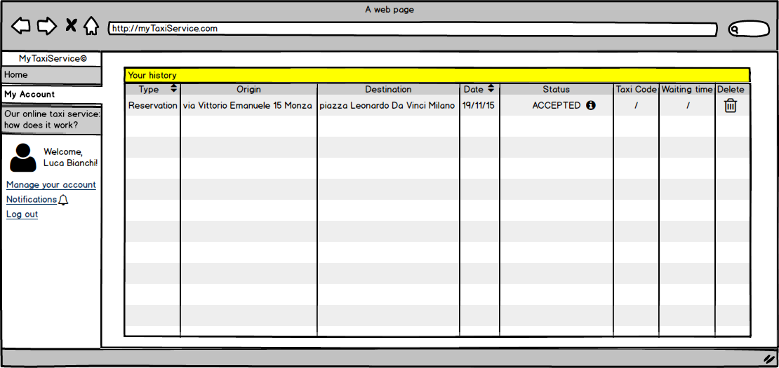
Using the “Show your history” function, Luca has another confirmation that his reservation has been regularly taken care by the system.
He notice also that he has the possibility to delete the reservation.

Slide 39
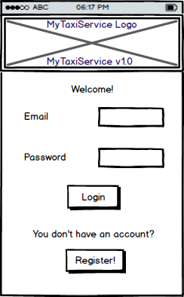
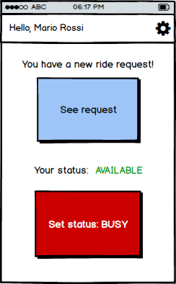
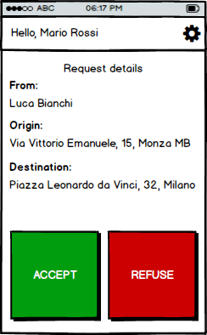
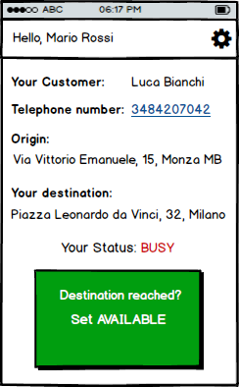
Early in the morning, the day of Luca’s exam, the taxi driver Mario Rossi is starting his workshift. Mario enters his taxi and opens MTS’s app on his mobile phone.
He inserts his driver’s account information in the home and logs in.
Now he is about to turn on the engine when he sees that the system has already a ride request for him.
Mario taps on “See request”, and the details appear on his phone’s screen.
He then decide to accept the request, and he taps on the green button.
The app is now displaying all the required information, and Mario can easily reach Luca’s home.

Slide 40
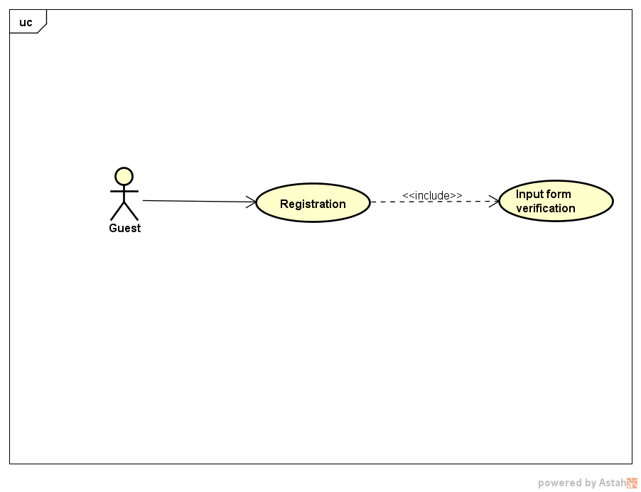
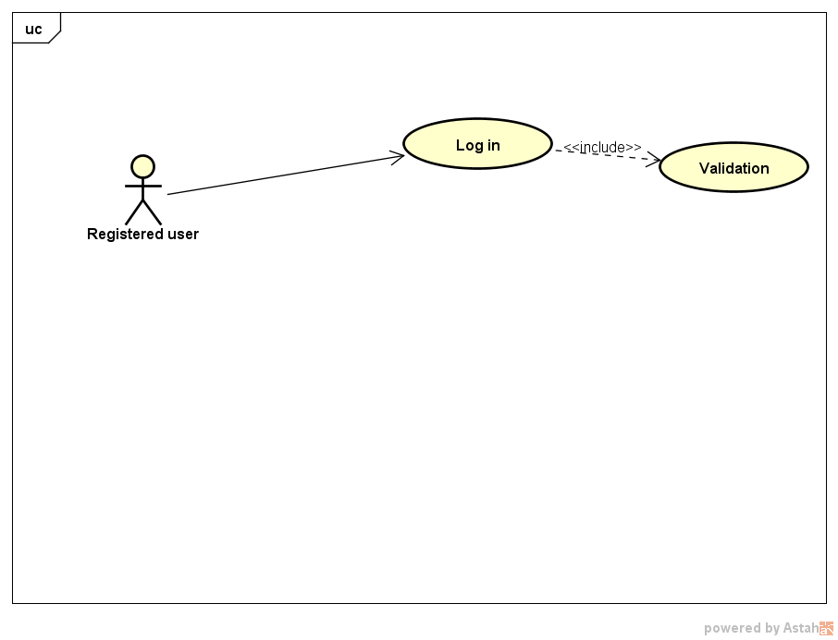
Use Cases
Registration
Log in

Slide 41
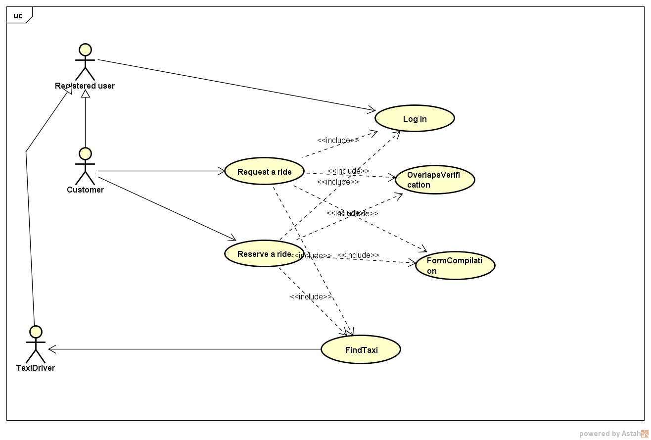
Use Cases – Request & Reservation
The two main features of the application involve the same set of internal functionalities.
Even if externally they are different functionalities, from the system’s point of view a reservation is basically a request delayed in time.
The main differences between the two will be the event flow visible in the sequence diagram.

Slide 42
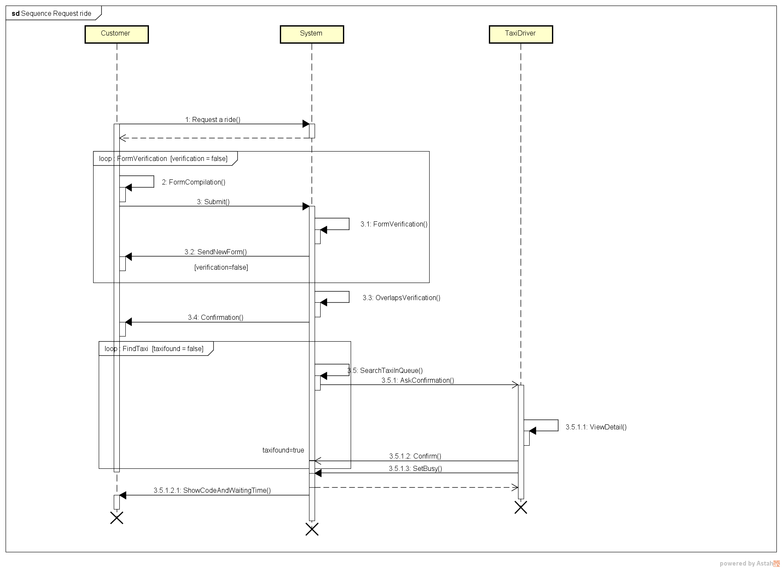
Successful request’s event flow
After the confirmation the system immediately starts to search a taxi.
Before the confirmation, the request has no state, because it doesn’t exist yet in the system.
After the confirmation, the request’s state is NotAssigned.
After the last operation, the request’s state is Assigned.

Slide 43
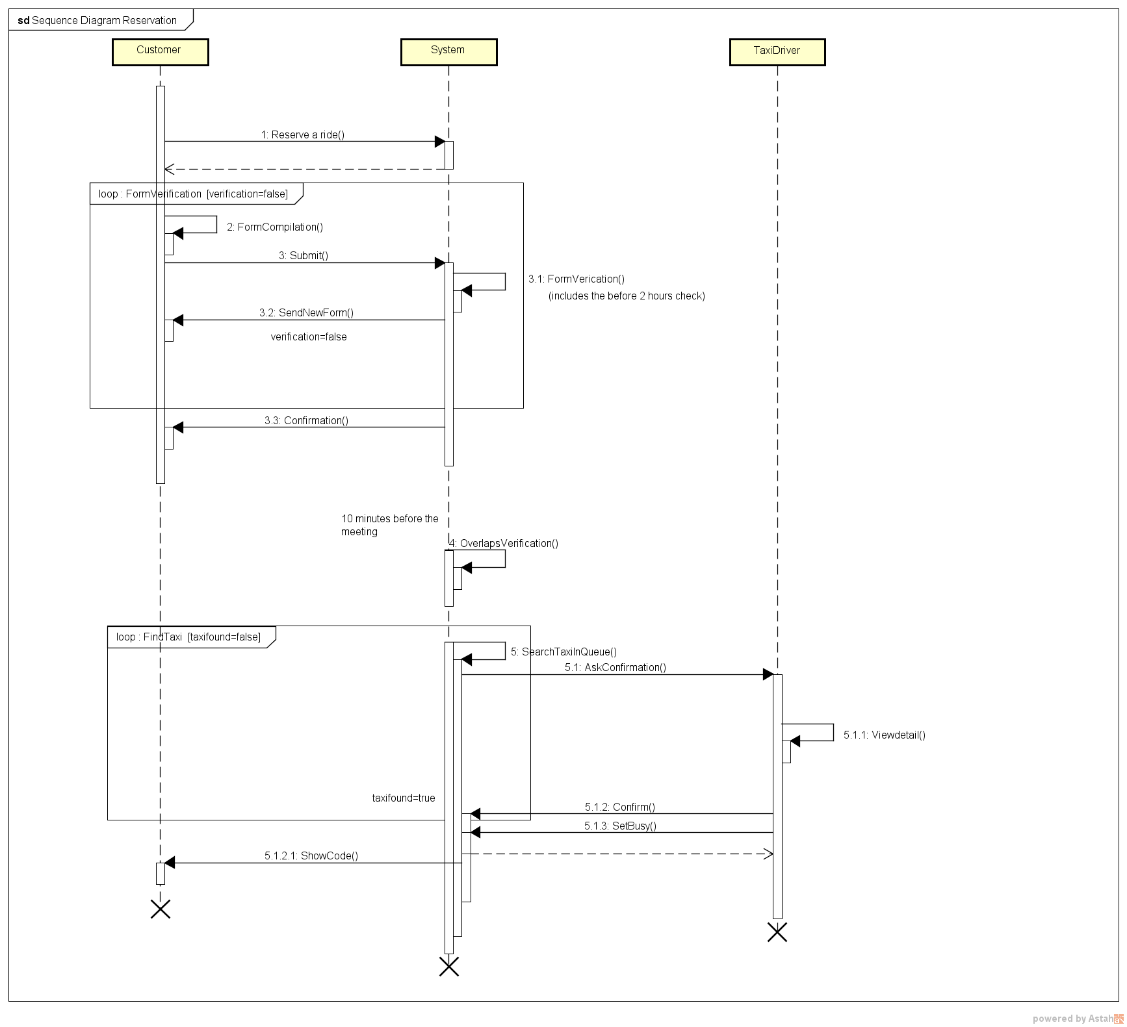
Successful reservation’s event flow
The overlaps verification and the taxi search are delayed until the last 10 minutes before the established time.
During that arbitrarily long time the reservation’s state is NotAssigned.
All the other steps and ride’s states are basically the same as in the request’s event flow.

Slide 44
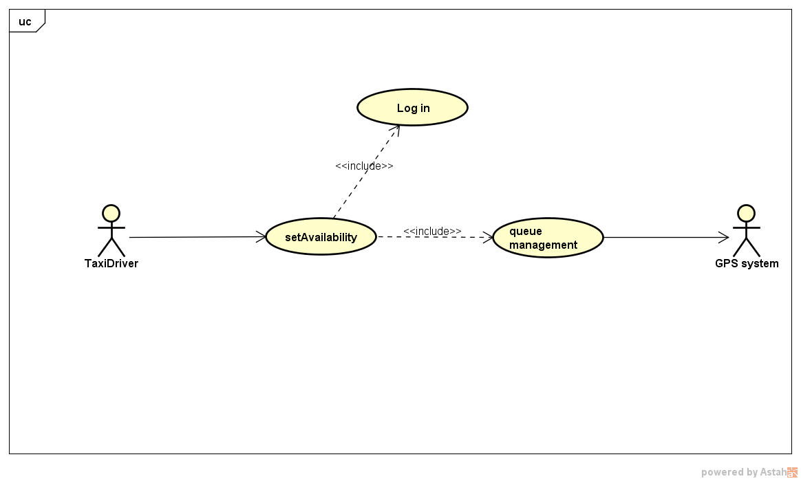
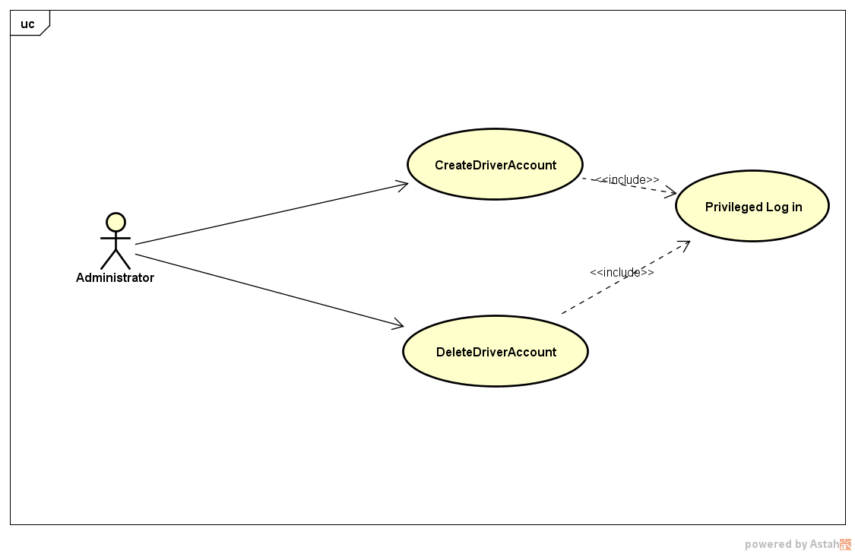
Use Cases
Set Availability
Create/Delete drivers

Slide 45
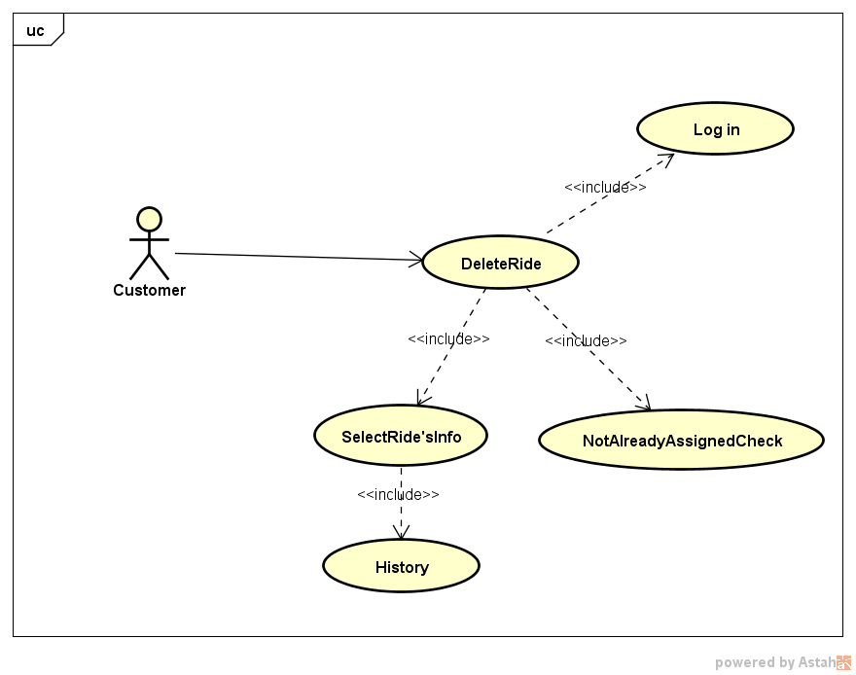
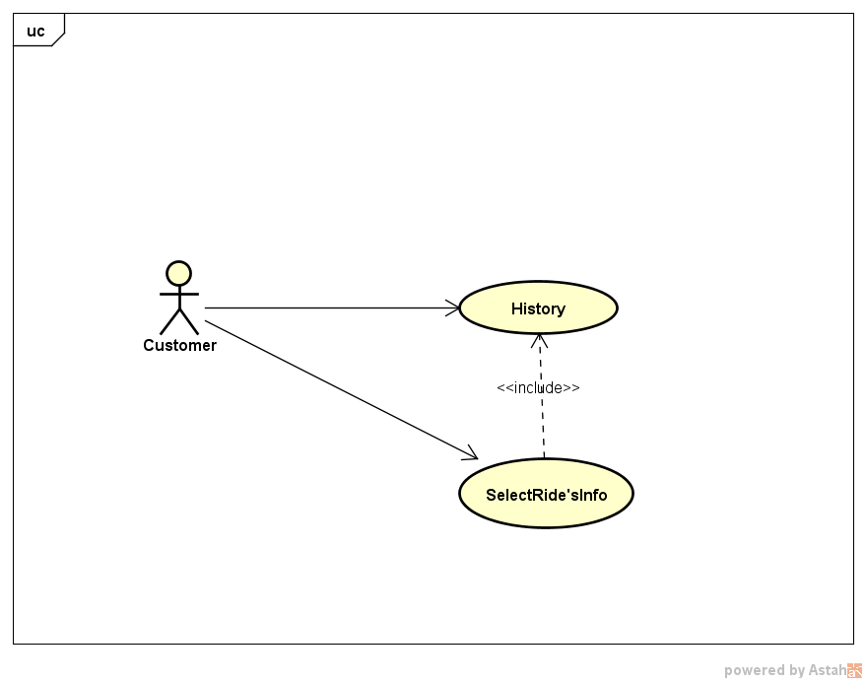
Use Cases
Delete a Ride
History
Rides, either requests or reservations, can be deleted by the customer if and only if the system hasn’t already assigned a taxi to them.

Slide 46
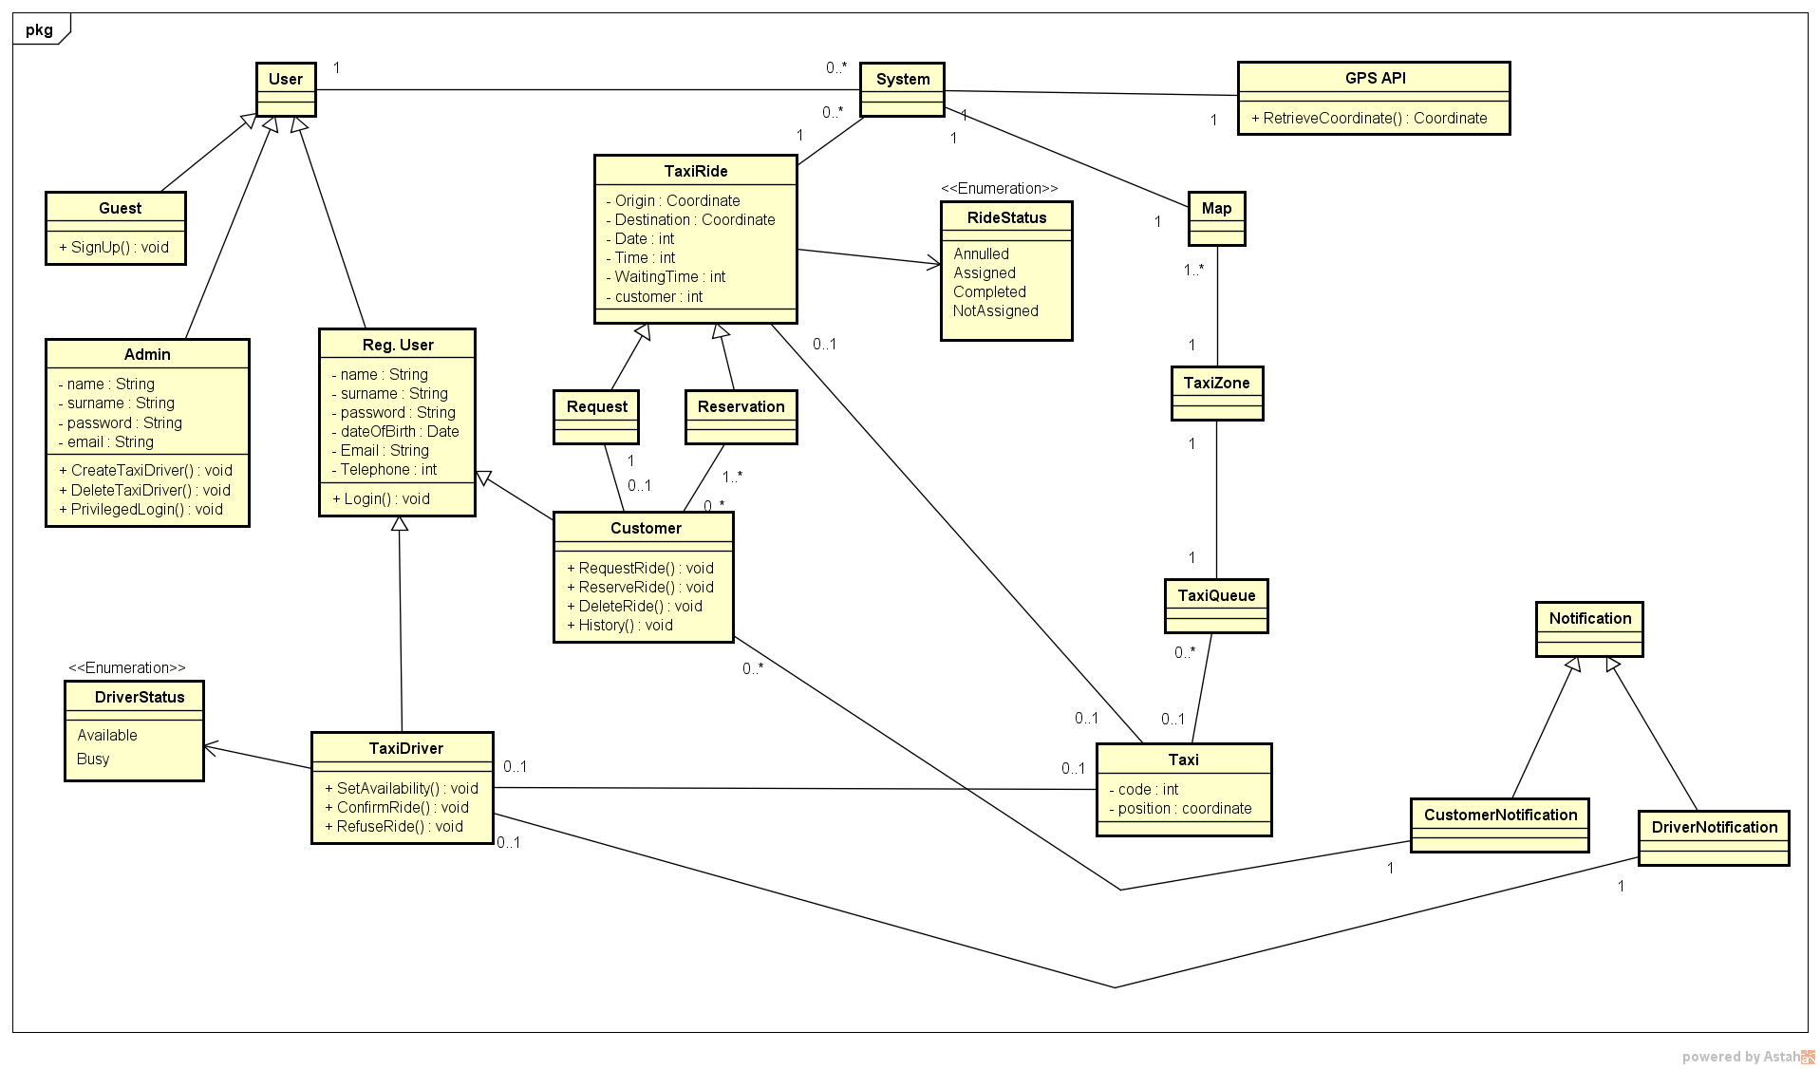
Class Diagram

Slide 47
Alloy - Signatures
Some basic signatures:
sig Integer {}
sig Strings {}
sig Date {}
sig Time {}
sig Coordinate{}
enum DriverStatus {Busy, Available}
enum RideStatus {Annulled, Assigned, Completed, NotAssigned}
Integer, Date and Time are used only to identify the type of attributes of some entities. String have been used also to show the difference between users (i.e. email and telephone number cannot be equal among users).

Slide 48
Alloy - Signatures
User signatures:
abstract sig User {}
sig Guest extends User {}
sig Admin extends User{
name: one Strings,
surname: one Strings,
email: one Strings,
password: one Strings
}
abstract sig RegUser extends User{
name: one Strings,
surname: one Strings,
password: one Strings,
birth: one Date,
email: one Strings,
telephone: one Strings
}
sig Customer extends RegUser{}
sig TaxiDriver extends RegUser{
status: one DriverStatus,
taxi: one Taxi
}

Slide 49
Alloy - Signatures
System signatures:
sig TaxiQueue {
hasTaxi: set Taxi
}
sig TaxiZone {
hasTaxiQueue: one TaxiQueue
}
one sig Map {
hasZone: some TaxiZone
}
one sig System {
map: one Map,
users: set User,
taxiRide: set TaxiRide
}

Slide 50
Alloy - Signatures
Taxi ride signatures:
abstract sig TaxiRide {
origin: one Coordinate,
destination: lone Coordinate,
date: one Date,
time: one Time,
waitingTime: lone Integer,
taxi: lone Taxi,
rideStatus: one RideStatus,
hasCustomer: one Customer
}
sig Request extends TaxiRide{
}
sig Reservation extends TaxiRide {
}
sig Taxi {
code: one Integer,
position: one Coordinate
}

Slide 51
Alloy - Facts
No users have the same email address and telephone number (i.e. there are no duplicate users).
fact noDuplicateUsers{
no disj u1,u2: RegUser| (u1.email = u2.email) or
(u1.telephone = u2.telephone)
no disj a1,a2:Admin | (a1.email = a2.email)
no disj a1:Admin, u1:RegUser | (a1.email = u1.email)
}
Every taxi zone has exactly one taxi queue.
fact queueOneZone{
TaxiZone <: hasTaxiQueue in TaxiZone one -> TaxiQueue
}

Slide 52
Alloy - Facts
There are no drivers with the same taxi (and therefore every taxi has exactly one different driver).
taxiOneDriver{
no disj d1,d2:TaxiDriver | d1.taxi = d2.taxi
#TaxiDriver = # Taxi
}
Every taxi can be assigned to one and only one queue.
fact taxiOneQueue{
all t1:Taxi | no disj q1,q2:TaxiQueue | (t1 in q1.hasTaxi and t1 in q2.hasTaxi)
all t2:Taxi | lone q3:TaxiQueue | t2 in q3.hasTaxi
}

Slide 53
Alloy - Facts
The map has the reference to every taxi zone.
fact taxiZoneInMap{
TaxiZone in Map.hasZone
}
A taxi (driver) cannot have more than one TaxiRide with the status “Assigned”.
fact driverOneRide{
no disj r1,r2:TaxiRide | (r1.taxi = r2.taxi) and (r1.rideStatus = Assigned) and (r2.rideStatus = r1.rideStatus)
}

Slide 54
Alloy - Facts
No more than one “Assigned” taxi ride for customer and no more than one request for customer.
fact RideLimit{
no disj r1,r2:TaxiRide | (r1.rideStatus = r2.rideStatus) and (r2.rideStatus = Assigned) and (r1.hasCustomer = r2.hasCustomer)
no disj r1,r2:Request | (r1.rideStatus = r2.rideStatus) and (r2.rideStatus = NotAssigned) and (r1.hasCustomer = r2.hasCustomer)
no disj r1,r2:Request | (r1.rideStatus = Assigned) and (r2.rideStatus = NotAssigned) and (r1.hasCustomer = r2.hasCustomer)
no disj r1:Request, r2:Reservation| (r1.rideStatus = NotAssigned) and (r2.rideStatus = Assigned) and (r1.hasCustomer = r2.hasCustomer)
}

Slide 55
Alloy - Facts
There are not taxi paired with a ride with the “Not Assigned” status.
fact noTaxiNotAssigned{
all r1:TaxiRide | (r1.rideStatus = NotAssigned) implies (r1.taxi = none)
}
“Assigned” and “Completed” rides must be bound to a taxi.
fact TaxiRideStatus{
all r1:TaxiRide | (r1.rideStatus != NotAssigned and r1.rideStatus!= Annulled) implies (#r1.taxi=1)
}

Slide 56
Alloy - Facts
The system must have the reference to all users and rides.
fact systemUserRide{
all u1:User | u1 in System.users
all r1:TaxiRide | r1 in System.taxiRide
}
Annulled rides must not be linked to any taxi.
fact AnnulledNoTaxi{
all r:TaxiRide | r.rideStatus = Annulled implies r.taxi = none
}
The origin of a ride cannot be equal to its destination.
fact originDifferentDestination{
no r1:TaxiRide | (r1.origin = r1.destination)
}

Slide 57
Alloy - Facts
A busy taxi must not be in a queue (because, of course, it contains only available taxis).
fact taxiBusyQueue{
all d1:TaxiDriver | ((d1.status = Busy) implies (no q1:TaxiQueue | d1.taxi in q1.hasTaxi))
}
An available taxi must be in a queue.
fact taxiAvailableQueue{
all d1:TaxiDriver | ((d1.status = Available) implies (some q1:TaxiQueue | d1.taxi in q1.hasTaxi))
}

Slide 58
Alloy - Facts
An “Assigned” taxi must imply that its driver is busy.
fact assignedEqualBusy{
no t:Taxi | taxi.t.rideStatus in Assigned and taxi.t.status=Available
}
An “Avaliable” taxi driver must not have any ride “Assigned”.
fact availableEqualnotAssigned{
all t:Taxi,d:TaxiDriver | (d.taxi = t and d.status = Available) implies(no r:TaxiRide | r.taxi = t and r.rideStatus = Assigned)
}

Slide 59
Alloy - Predicates
These are some of the predicates that we have used with some assertions and in the show() predicate in order to generate some specific worlds:
//Add an assigned ride
pred addAssignedRide(s1,s2:System){
one r1:TaxiRide | r1.rideStatus = Assigned and s2.taxiRide=s1.taxiRide + r1
}
//Add an annulled ride
pred addAnnulledRide(s1,s2:System){
one r1:TaxiRide | r1.rideStatus = Annulled and s2.taxiRide=s1.taxiRide + r1
}
//Add a completed ride
pred addCompletedRide(s1,s2:System){
one r1:TaxiRide | r1.rideStatus = Completed and s2.taxiRide=s1.taxiRide + r1
}

Slide 60
Alloy - Predicates
//Add 2 customers
pred add2Customer(s1,s2:System,c1,c2:Customer){
s2.users=s1.users + c1+c2
}
//Add 2 reservations
pred add2Reservation(s1,s2:System, res1,res2:Reservation){
s2.taxiRide=s1.taxiRide + res1 + res2
}
//Add 2 requests
pred add2Request(s1,s2:System, req1,req2:Request){
s2.taxiRide=s1.taxiRide + req1 + req2
}
//Add 1 busy and 1 available taxi driver
pred atleast1busy1available{
some d:TaxiDriver | d.status = Busy
some d:TaxiDriver | d.status = Available
}

Slide 61
Alloy - Assertions
These are some of the assertions that we have used to verify the consistency of our model:
// All these cardinality equivalences must be satisfied
assert numbersEquivalence{
#Taxi = #TaxiDriver
#TaxiZone = #TaxiQueue
#System.users = # User
#System.taxiRide = #TaxiRide
#(status.Available).taxi = #TaxiQueue.hasTaxi // the number of available taxi must be equal to the number of taxi in all the queues
}
// Busy taxi drivers may not be assigned to a ride, because of the possibility of standard customers
assert driversStandardCustomer{
all s1,s2:System | addBusyWithoutRide[s1,s2] implies !(status.Busy in (TaxiDriver <: taxi).(TaxiRide.(TaxiRide <:taxi)))
}

Slide 62
Alloy - Assertions
//All the available taxi belongs to a taxi zone
assert allAvailableInOneZone{
all t:Taxi | ((TaxiDriver <: taxi).t).status = Available implies one z:TaxiZone | t in z.hasTaxiQueue.hasTaxi
}
//There are no taxi without drivers
assert noTaxiWithoutDrivers{
all t:Taxi | one d:TaxiDriver | d.taxi=t
}
//There are no drivers without taxi
assert noDriversWithoutTaxi{
all d:TaxiDriver | one t:Taxi | d.taxi=t
}
// no ride without customers
assert noRideWithoutCustomer{
all r:TaxiRide | one c:Customer| r.hasCustomer = c
}

Slide 63
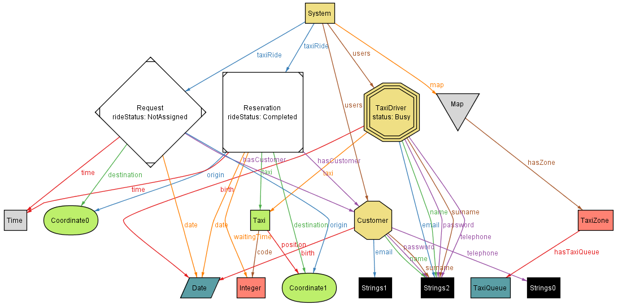
Alloy - Worlds
This is a possible world with two taxi rides, a single taxi driver and a customer.

Slide 64
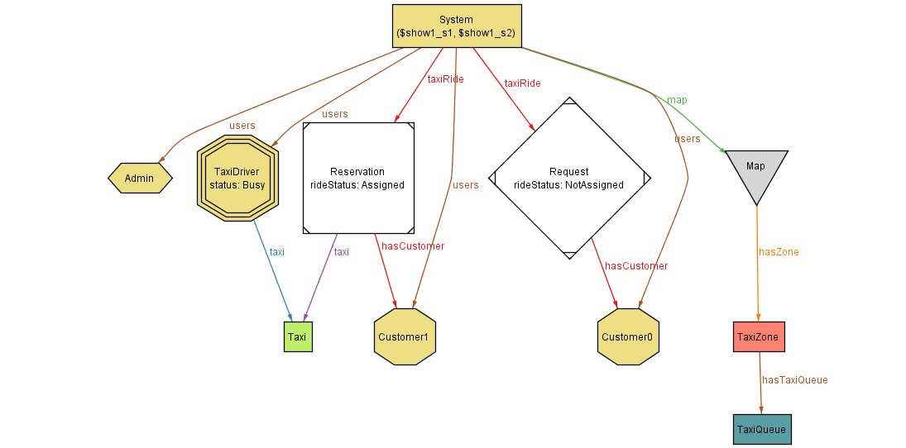
Alloy - Worlds
In the following alternative worlds, Strings and other non-essential signatures have been removed in order to clarify the relation between the main entities.

Slide 65
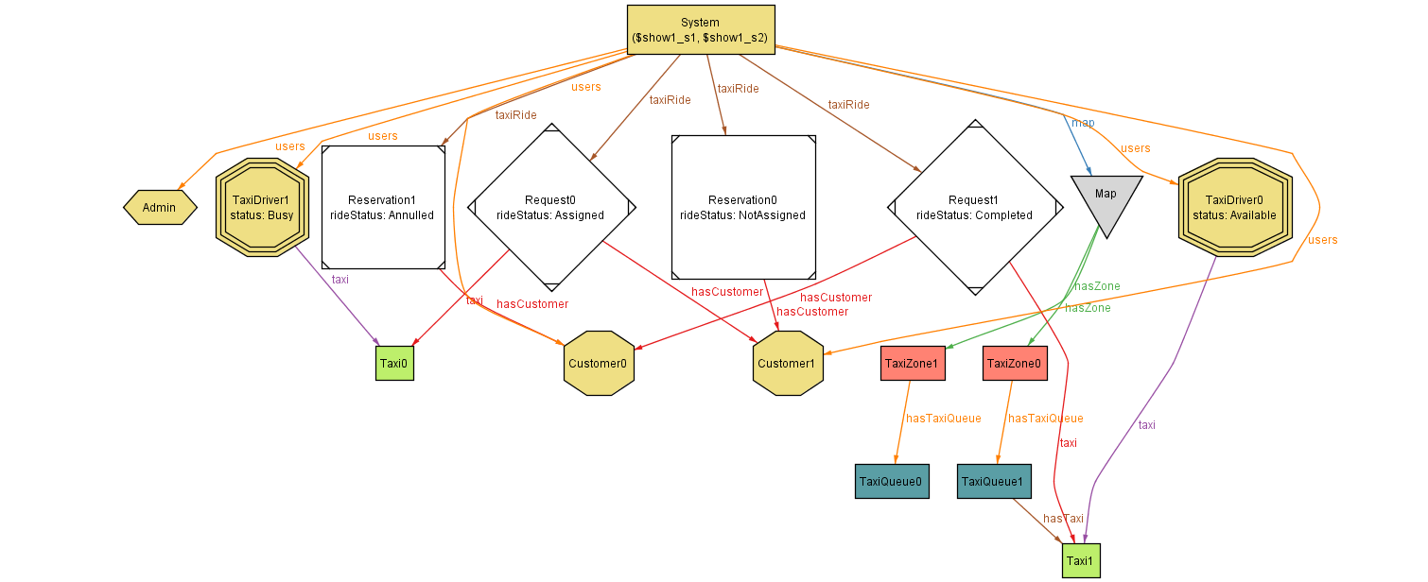
Alloy - Worlds

